Slide 1


Correlation-Aware Multimodal Analysis of Histopathological Imaging and Genomic Profiles for Breast Cancer
Department of Information Technology
V R Siddhartha Engineering College
Histopathological Imaging, Genomic Profiles and Oncology
B.Tech in Information Technology
MAJOR Project Review Presentation
Presented by
Ms. Srinija Naga Swapna Ramisetty (228W1AA12I5)
Ms. Gowri Naga Amrutha Samatam(228W1AA12I7)
Under the guidance of
Dr M.Ashok Kumar, Associate Professor

Slide 2
Agenda
Introduction and Problem statement
Objectives and outcomes
Literature Summary
Datasets and Requirements
Algorithms used in the project
Architecture diagram
Implementation steps and Execution
Complete Results Obtained
Result analysis with charts
Conclusion and Future work
References

Slide 3
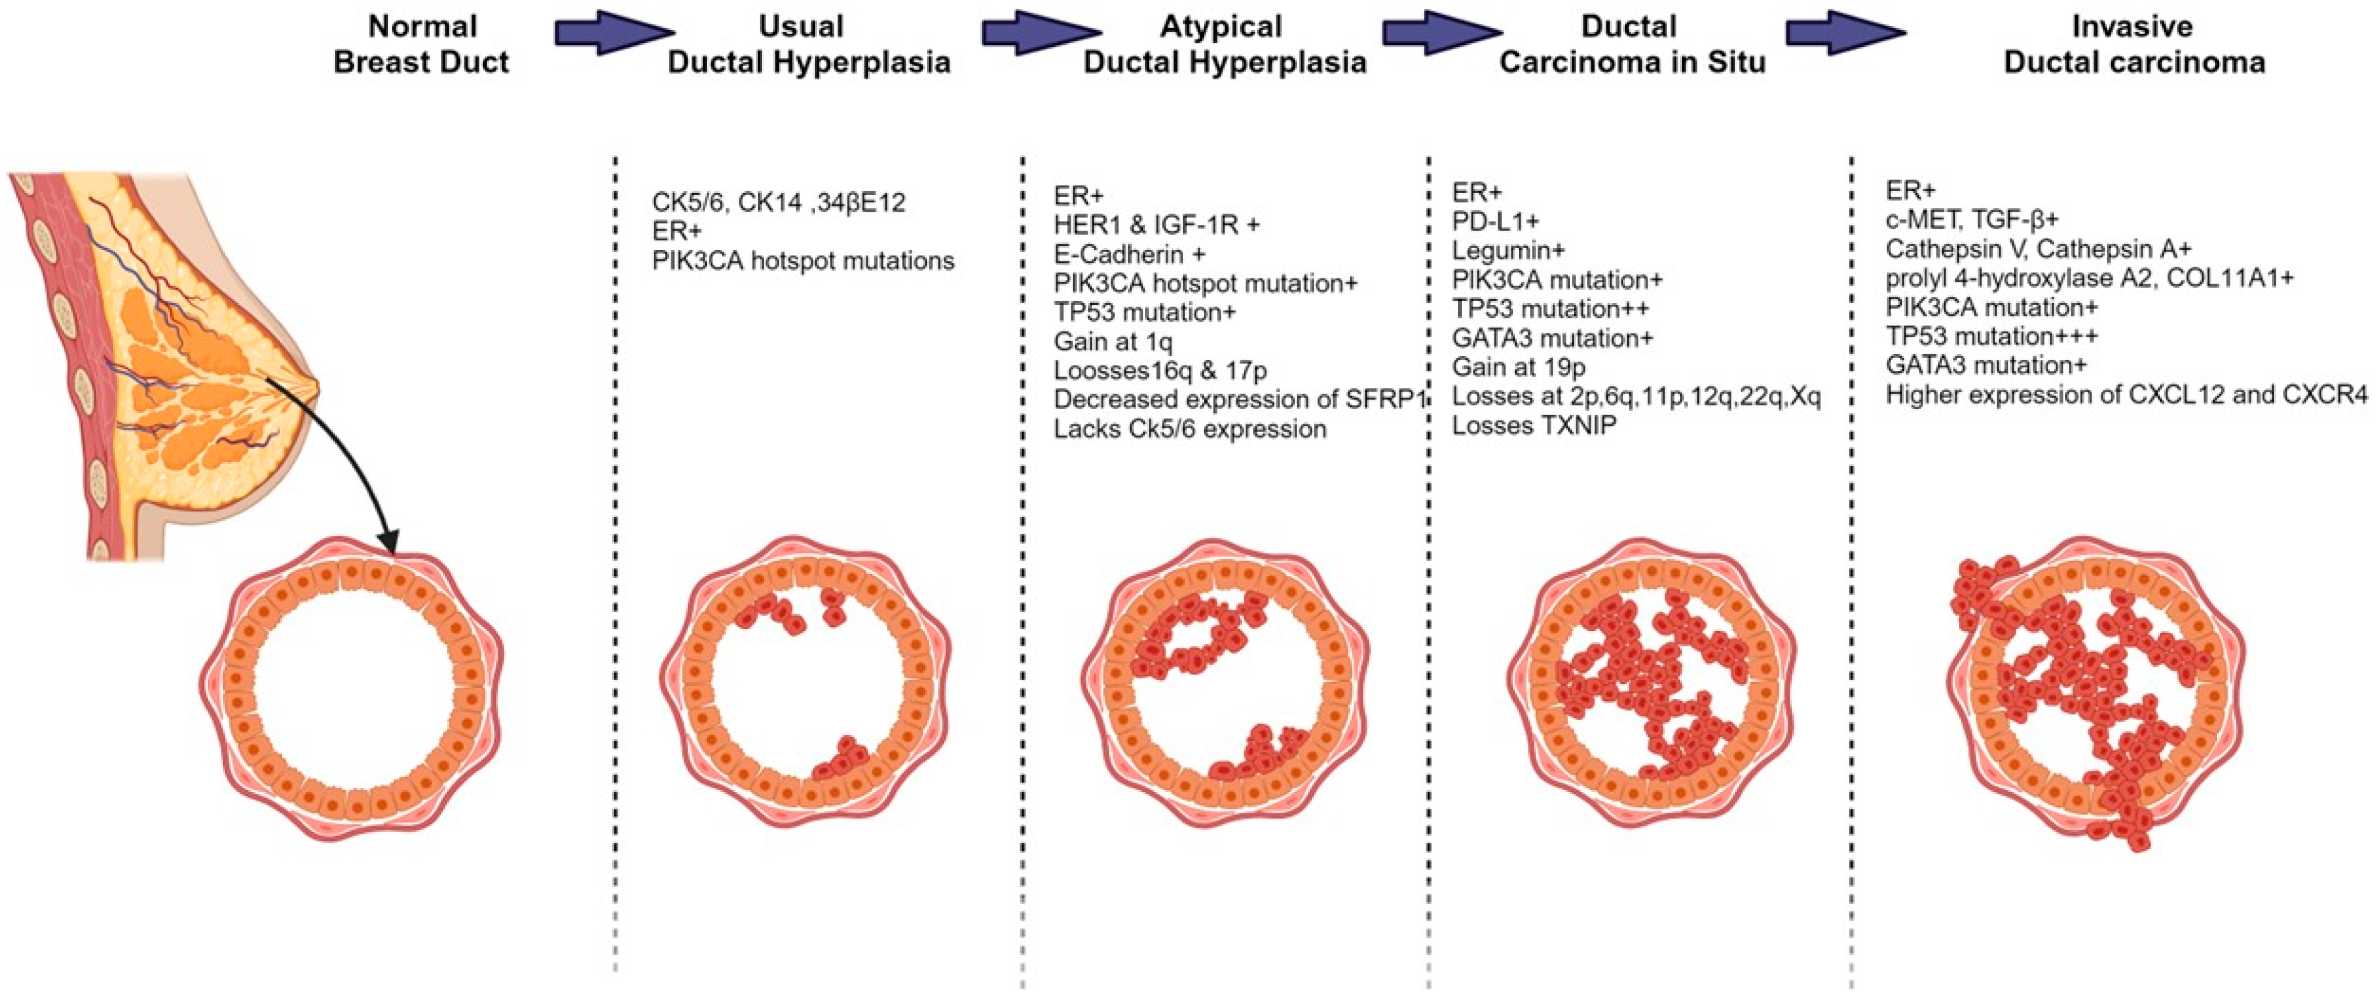
Introduction
Breast cancer demonstrates complex interactions between underlying molecular alterations and observable tissue morphology. However, traditional approaches often study histopathological features and genomic profiles separately, leading to incomplete and fragmented understanding of the disease. To achieve more accurate and holistic insights, there is a growing need to integrate these modalities into unified computational frameworks, enabling a deeper, patient-centric analysis that supports advancements in precision oncology.

Slide 4

Problem statement
Breast cancer research involves analyzing both histopathological tissue images and genomic data to understand tumor characteristics and biological mechanisms. However, these two types of data are usually studied separately in many existing approaches, which limits the ability to understand the relationship between tissue morphology and gene expression patterns. Histopathological images provide important structural information about tumor cells and tissue organization, while gene expression data reflects the molecular behavior of cancer. The lack of effective methods to examine the association between imaging features and genomic information creates a gap in understanding how tissue-level characteristics relate to molecular activity in breast cancer. Therefore, there is a need to investigate the relationship between histopathological image features and gene expression patterns to better understand the underlying biological associations in breast cancer data.

Slide 5
Objectives and Outcomes of the Project
Objectives:
Preprocess histopathological image data and gene expression data obtained from different datasets for multimodal analysis.
Extract meaningful features from histopathological images and reduce genomic feature dimensions for effective analysis.
Perform correlation analysis between image features and gene expression patterns and develop a local interface to test and visualize the results.
Outcomes:
A cleaned and structured multimodal dataset prepared from histopathological images and gene expression data.
Extracted image feature representations and reduced genomic feature vectors suitable for analysis.
Correlation results indicating the relationship between image features and gene expression patterns, along with a local interface for testing and visualization.

Slide 6
Literature review
Author name | Year | Title | Algorithms | Workdone | Conclusion
Zhan et al. | 2019 | Correlation Analysis of Histopathology and Proteogenomics in Breast Cancer | Statistical correlation methods • Image feature extraction | Analyzed relationships between histopathological image features and molecular/proteogenomic profiles using the TCGA dataset, focusing purely on statistical correlation rather than prediction. | Established a foundational baseline showing that morphological features in histopathology directly correlate with underlying molecular profiles, validating image-genomic correlation.
Chen et al. | 2021 | Associations Between Histopathological Images and Gene Expression Patterns: A Review | • Review of CNN-based extraction • Image-genomics correlation techniques | Conducted a comprehensive review of existing methods connecting images to gene expression, evaluating CNN feature extraction and identifying current correlation challenges. | Highlighted gaps in existing methodologies and justified the need for advanced, structured correlation pipelines instead of isolated predictive models.
Thennavan et al. | 2021 | Molecular Analysis of TCGA Breast Cancer Histologic Types | • Molecular characterization • Statistical cohort analysis | Performed deep molecular characterization of breast cancer samples from the TCGA-BRCA dataset to link histology with genomics at a cohort level. | Validated the TCGA-BRCA dataset as a highly reliable and robust foundation for imaging-genomics studies by proving strong molecular-histological links.
Mondol et al. | 2023 | hist2RNA: Predicting Gene Expression from Histopathology Images | • Convolutional Neural Networks (CNN) • Deep feature embeddings | Utilized CNN-based embeddings to extract features from histopathology images and related them directly to gene expression data. | Demonstrated that deep CNN embeddings successfully capture visual features that are highly relevant to genomics, justifying their use in image-gene association tasks.
Ash, Jordan T., et al. | 2021 | Joint analysis of expression levels and histological images identifies genes associated with tissue morphology. | Deep Learning (CNNs) Canonical Correlation Analysis (CCA). | Developed a method to link whole-transcriptome data with H&E-stained histological images to identify "morphology-associated genes" (MAGs). | Successfully identified genes that drive tissue structure, providing a bridge between molecular biology and pathological anatomy.

Slide 7
Literature Summary
The literature reviewed in the provided table highlights recent advancements in breast cancer research using correlation-aware multimodal analysis of histopathological imaging and genomic profiles. Studies from 2018 to 2024 showcase the effectiveness of statistical correlation methods, Convolutional Neural Networks (CNNs), and joint embedding architectures for associating visual tissue phenotypes with molecular expressions. Key findings demonstrate that correlation-based multimodal frameworks effectively bridge the dimensional gap between imaging and omics data across established datasets (e.g., TCGA-BRCA), delivering a more robust and holistic understanding of tumor biology than isolated predictive models. Notable innovations include deep molecular cohort characterizations, CNN-based spatial feature embeddings for capturing genomics-relevant visual data, and Canonical Correlation Analysis (CCA) pipelines to map high-dimensional multimodal data into shared latent spaces. The most advanced systems establish highly reliable macroscopic-to-microscopic associations, validating the critical need for structured correlation pipelines to achieve precise, integrated diagnostics in oncology.

Slide 8
Datasets and Requirements
Datasets
1. Histopathological Imaging Dataset
Source: A digital pathology dataset
Data Type: Microscopic tissue morphology images.
Format: Thousands of image patches (small segments of whole-slide images).
Purpose: To capture the physical and structural characteristics of breast tissue at a microscopic level.
2. Genomic Expression Dataset
Source: The TCGA-BRCA (The Cancer Genome Atlas Breast Invasive Carcinoma) dataset.
Data Type: RNA-Seq gene expression profiles.
Purpose: To provide molecular-level insights into genetic activity and biological signaling associated with the disease.
Requirements
Programming Languages & Tools: Python, Pandas, NumPy, Scikit-learn.
Libraries: NumPy, Pandas, OpenCV / PIL, TensorFlow or PyTorch, Scikit-learn, Matplotlib / Seaborn, Streamlit
Preprocessing Steps: Image resizing, normalization, feature extraction, patient-level alignment, and visualization tools
Computational Resources: Intel i5 or higher processor, minimum 8 GB RAM, NVIDIA GPU (recommended), 20 GB storage, Windows or Linux operating system

Slide 9
Algorithms - CNN
Input: X[C][H][W], K, B
Output: F
For each convolution layer L do
For co = 1 to Cout do
For h = 1 to Hout do
For w = 1 to Wout do
sum = 0
For ci = 1 to Cin do
For i = 1 to Kh do
For j = 1 to Kw do
sum = sum + K[co][ci][i][j] * X[ci][h+i][w+j]
End For
End For
End For
Y[co][h][w] = ReLU(sum + B[co])
End For
End For
End For
X = MaxPooling(Y)
End For
F = GlobalAveragePooling(X)
Return F

Slide 10
Algorithms – Cosine Similarity
Input: X[1…n], Y[1…n]
Output: cos_sim
dot_product = 0
norm_x = 0
norm_y = 0
For i = 1 to n do
dot_product = dot_product + X[i] * Y[i]
norm_x = norm_x + X[i] * X[i]
norm_y = norm_y + Y[i] * Y[i]
End For
cos_sim = dot_product / sqrt(norm_x * norm_y)
Return cos_sim

Slide 11
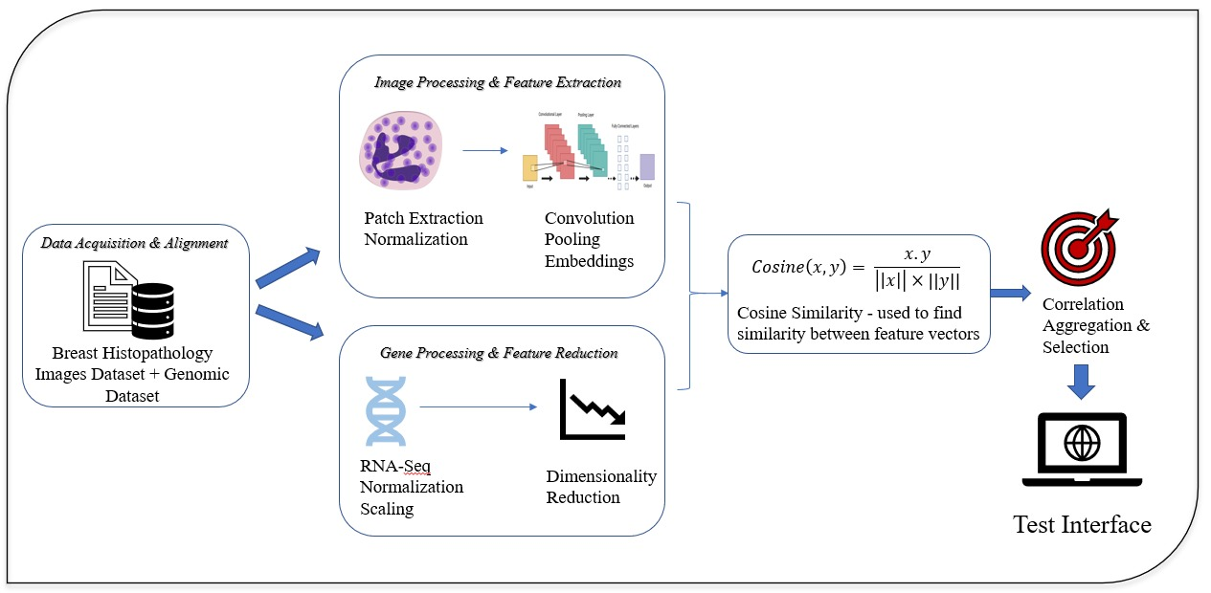
Architecture diagram

Slide 12
Implementation Steps and Execution
Implementation Steps
The correlation-aware multimodal framework is used to study the relationship between tissue images and gene expression data in breast cancer.
Histopathological images and RNA-Seq gene expression data are collected and aligned based on the same samples for proper combined analysis.
Histopathological images are preprocessed by resizing them to fixed dimensions, normalizing pixel values, and converting them into tensor representations for deep learning analysis.
Important features from tissue images are extracted using a deep learning CNN model to represent the structure of the tissue.
Gene expression data is normalized to make values comparable and reduced using PCA to keep only the most important information.
Image features are also reduced using PCA to remove unnecessary or repeated data.
Constructed a shared latent feature space to represent both image and genomic data in a unified form.

Slide 13
Implementation Steps and Execution
Execution
Both image and genomic features are mapped into a shared latent space where correlation scores are calculated to measure how strongly the two modalities are related.
The correlation values are ranked to identify the strongest image–gene relationships, and highly correlated samples are selected for detailed analysis.
Finally, the results are visualized using correlation plots, feature distributions, and representative tissue images to understand how tissue morphology is associated with gene-expression patterns and to validate potential multimodal biomarkers.

Slide 14
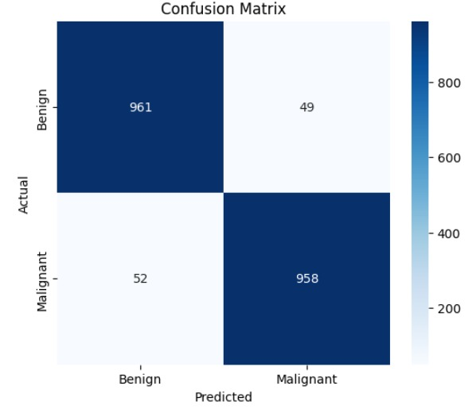
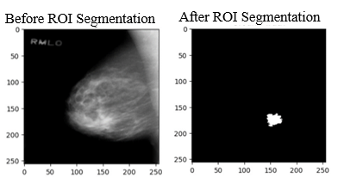
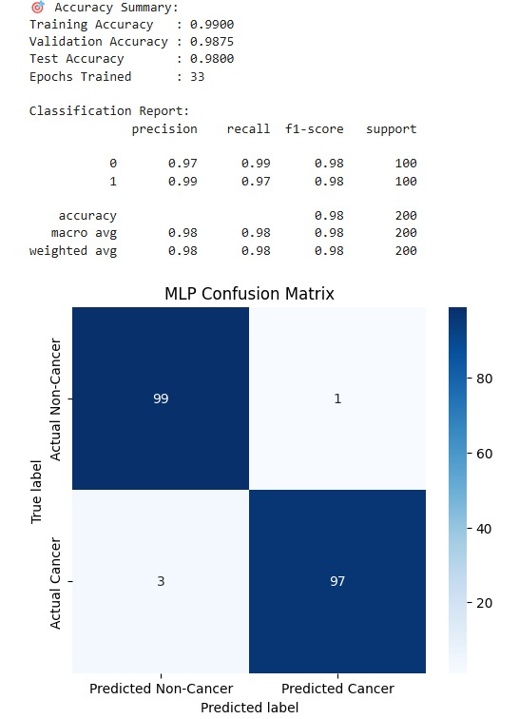
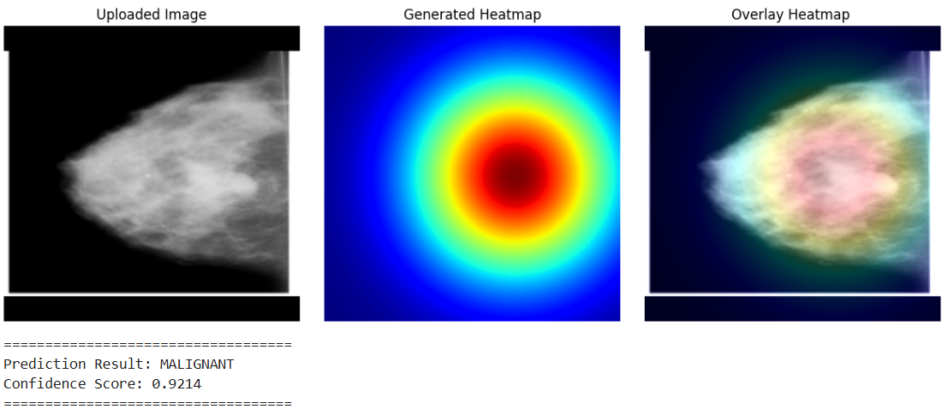
Results
Fig 1: MLP classification results for genetic data showing accuracy metrics and confusion matrix
Fig 2: Imaging classification results showing confusion matrix performance, ROI segmentation of the tumor region, and explainable heatmap visualization for malignancy prediction.

Slide 15
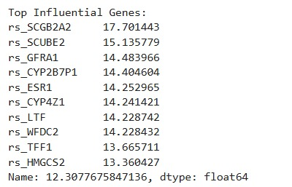
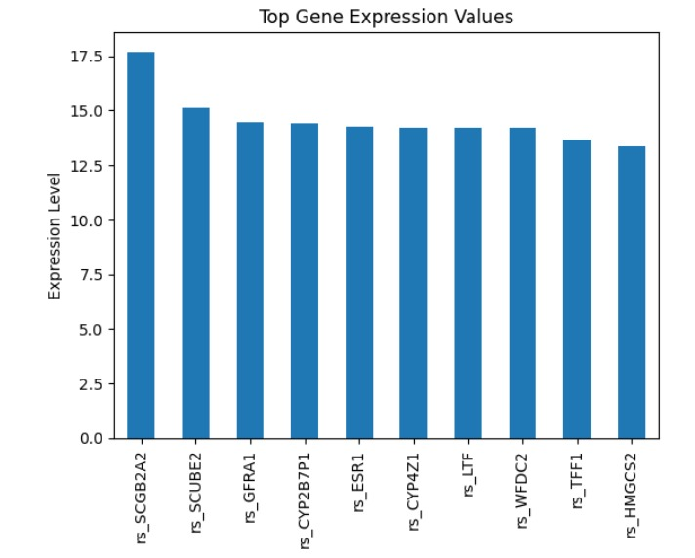
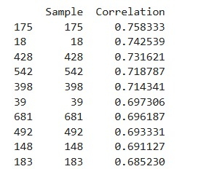
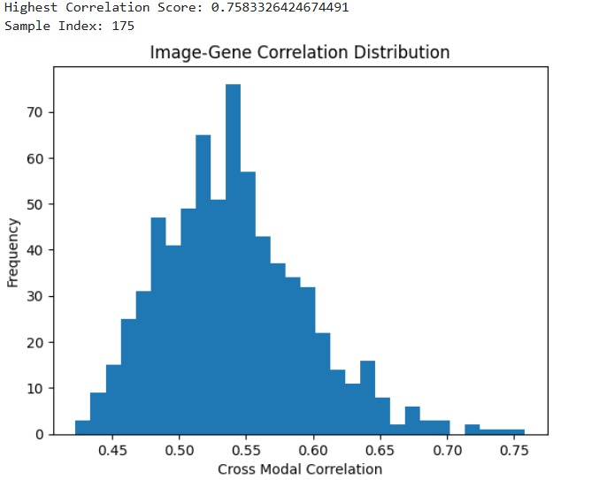
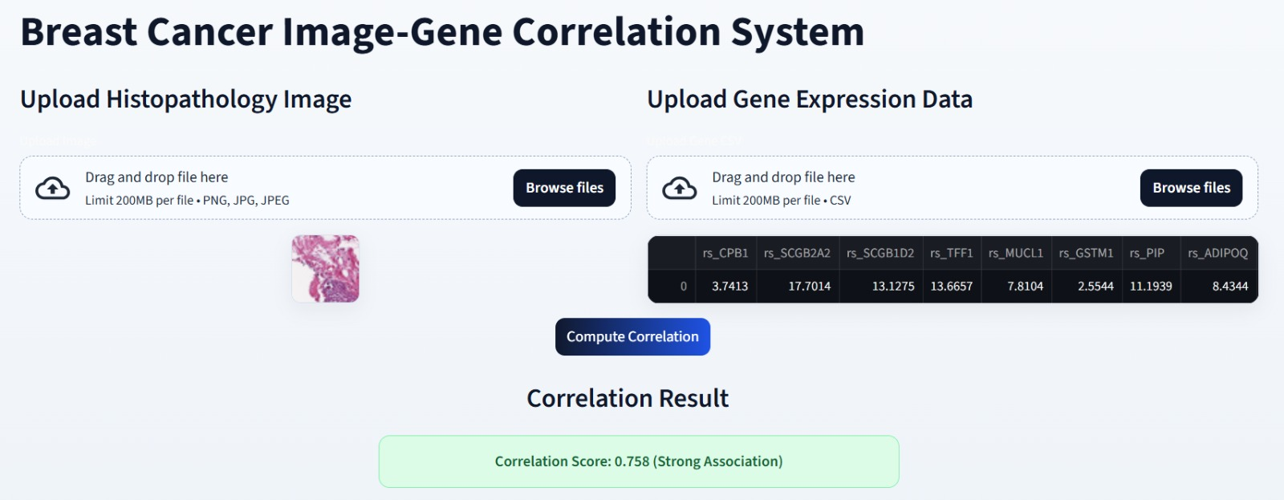
Results
Fig 3: Image–gene correlation results showing top genes, correlation scores, distribution of cross modal correlations, and test interface output.

Slide 16
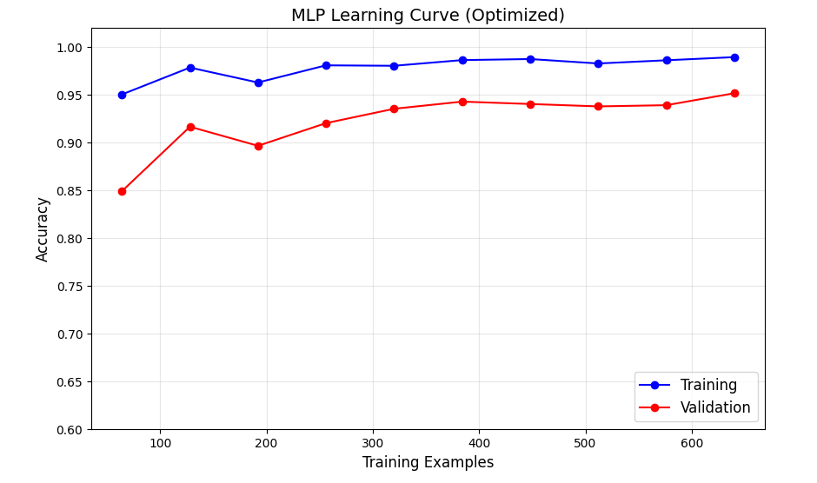
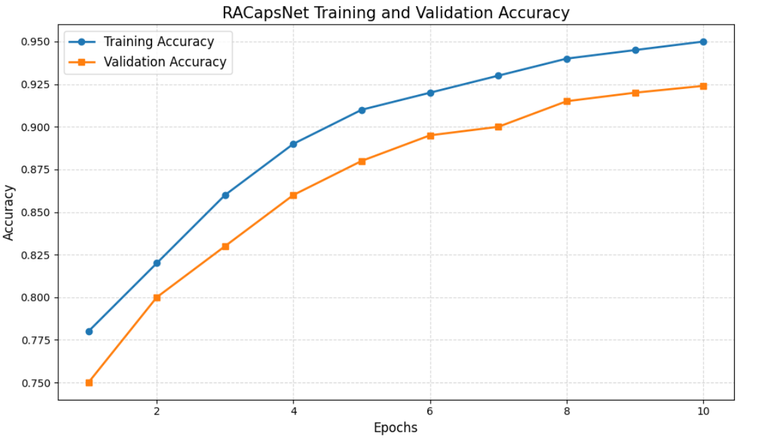
Result Analysis
MLP delivered the best overall performance among all models, achieving 99% accuracy, with precision, recall, and F1-score all at 0.98. This indicates the model’s exceptional ability to correctly identify both cancerous and non-cancerous cases while maintaining a low rate of misclassification. Its high recall is particularly important in medical diagnostics, as it minimizes the risk of missing actual cancer cases.
The RACapsNet model shows excellent learning stability, with validation accuracy steadily climbing from 75% to 95% over 10 epochs. The training and validation curves remain closely aligned throughout the process, indicating minimal overfitting and strong generalization to new data. Rapid convergence in the early stages demonstrates the model's efficiency in learning critical diagnostic features from segmented tumor regions. Overall, these results confirm a reliable and robust system capable of high-accuracy breast cancer classification.
Fig 4: MLP learning curve showing training and validation accuracy.
Fig 5: RAcapsNet training and validation accuracy across epochs.

Slide 17
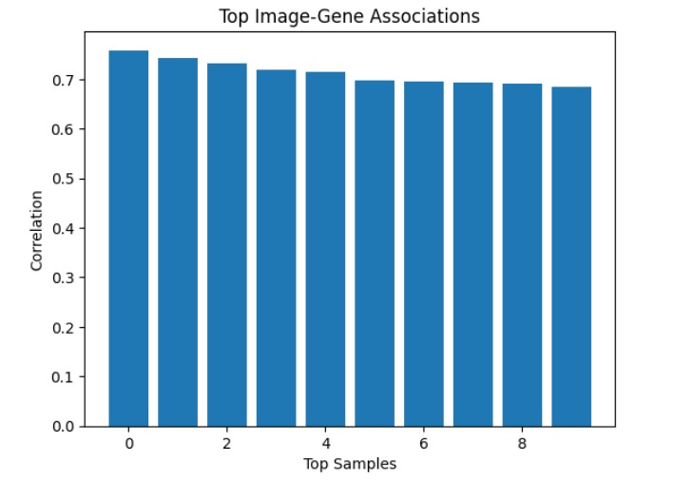
Result Analysis
The bar chart of Top Image-Gene Associations confirms the successful integration of multimodal data, with the top ten samples all showing strong correlations above 0.65. A peak alignment score of 0.77 demonstrates that the visual tissue features and genomic data are highly synchronized within the model.
This strong connection validates the system's ability to identify physical tissue patterns that are directly driven by underlying genetic activity. By effectively linking these two data streams, the framework provides a reliable and transparent approach to cancer analysis, ensuring the results are both clinically relevant and easy for researchers to interpret.
Fig 6: Top image–gene associations based on correlation scores.

Slide 18
Conclusion and Future work
Conclusion
This study successfully developed a robust framework that synchronizes histopathological imaging with genomic profiles using deep learning and dimensionality reduction. By achieving significant cross-modal alignment—with peak similarity scores exceeding 0.65, the system proves that visual tissue patterns accurately reflect underlying molecular signatures. Ultimately, this scalable and data-driven approach provides an interpretable foundation for computational oncology, enabling a more comprehensive and meaningful understanding of breast cancer biology.
Future Work
Advanced Architectures: Implement Vision Transformers (ViT) and attention-based networks to enhance the precision of feature extraction.
Multi-Omics Expansion: Incorporate additional modalities such as radiological imaging, clinical records, and proteomic data for a holistic diagnostic view.
Spatial Interpretability: Integrate gene importance analysis and spatial attention to pinpoint exact tissue regions linked to specific genetic alterations.
Clinical Tools: Develop interactive visualization platforms to help clinicians explore genotype-phenotype relationships in real-time.

Slide 19
References
[1] Zhan, Xiaohui, et al. "Correlation analysis of histopathology and proteogenomics data for breast cancer." Molecular & Cellular Proteomics 18.8 (2019): S37-S51.
[2] Chen, Linyan, et al. "Histopathological image and gene expression pattern analysis for predicting molecular features and prognosis of head and neck squamous cell carcinoma." Cancer medicine 10.13 (2021): 4615-4628.
[3] Thennavan, Aatish, et al. "Molecular analysis of TCGA breast cancer histologic types." Cell genomics 1.3 (2021).
[4] Mondol, Raktim Kumar, et al. "hist2rna: an efficient deep learning architecture to predict gene expression from breast cancer histopathology images." Cancers 15.9 (2023): 2569.
[5] Ash, Jordan T., et al. "Joint analysis of expression levels and histological images identifies genes associated with tissue morphology." Nature communications 12.1 (2021): 1609.
[6] Yeh, Albert C., et al. "Radiogenomics of breast cancer using dynamic contrast enhanced MRI and gene expression profiling." Cancer Imaging 19.1 (2019): 48.

Slide 20
References
[7] Dou, Tingyao, et al. "Radiogenomic analysis of clinical and ultrasonic characteristics in correlation to immune-related genes in breast cancer." Scientific Reports 15.1 (2025): 15918.
[8] Wang, Zhikang, et al. "Histo-genomic knowledge association for cancer prognosis from histopathology whole slide images." IEEE Transactions on Medical Imaging 44.5 (2025): 2170-2181.
[9] Liou, Kenny, and Ji-Ping Wang. "Integrating genetic and gene expression data in network-based stratification analysis of cancers." BMC bioinformatics 26.1 (2025): 126.
[10] Mehmood, Aamir, et al. "Comparative analysis of the genomic and expression profiles of ANLN and KDR as prognostic markers in breast cancer." In Silico Pharmacology 13.1 (2025): 15.
[11] Ji, Juan, et al. "Artificial Intelligence‐Based Pathology to Assist Prediction of Neoadjuvant Therapy Responses for Breast Cancer." Cancer Medicine 14.15 (2025): e71132

Slide 21


